Slide 1

Data Analysis and Statistical Inference STA101-FALL 2018
Syllabus Overview
https://www2.stat.duke.edu/courses/Spring19/sta101.001/
Dr. Victoria Ellison

Slide 2
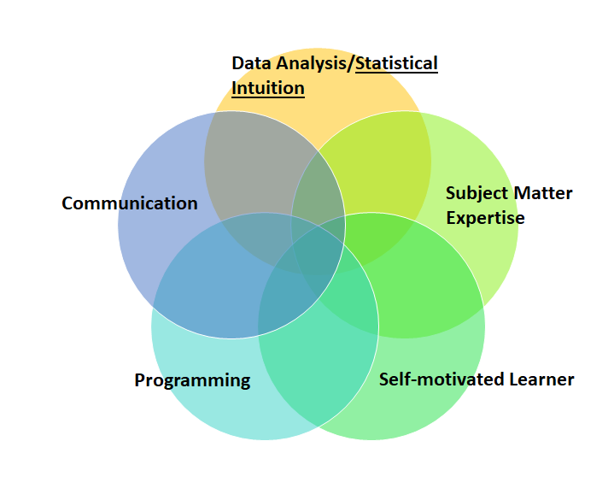

What do you get out of this course?
Data is everywhere!
What industry + academia is looking for
you
https://www.amstat.org/asa/education/Curriculum-Guidelines-for-Undergraduate-Programs-in-Statistical-Science.aspx

Slide 3
What do you get out of this course?
Current State of Data Analysis/Science:
Field of data analysis is broad! (Impossible to know everything.)
New and useful statistical analyses and algorithms are developed everyday!
Datasets are larger!
https://www.amstat.org/asa/education/Curriculum-Guidelines-for-Undergraduate-Programs-in-Statistical-Science.aspx

Slide 4
Objectives
Statistics:
“A branch of mathematics dealing with the collection, analysis, interpretation, and presentation of masses of numerical data.” –Webster’s New Collegiate Dictionary
Main Objective of Statistics:
“Make an inference about a population based on information contained in a sample from that population and to provide an associated measure of goodness for the inference.” –Wackerly et al. 2002
Main Objective of the Course:
Make sense of data using statistical tools.
Make informed decisions.
Explore relationships between variables.

Slide 5
Course Roadmap
Form Research Question
(about Population)
Collect Data (Sample)
Exploratory Data Analysis (of Sample)
*Summary Statistics
*Visualizations
Make Inferences and Conclusions (about Population)

Slide 6
Class Times and Locations
Main Lecture:
M/W 3:05pm-4:20pm French Science 2231
Instructor: Dr. Victoria Ellison
(Lecture TAS: Melanie Lai Wai and Lavonne Hoang)
Labs Sections:
TH 8:30am-9:45am, Perkins LINK 088 Classroom 4 (Lab TA: Tessa Johnson, tessa.johnson@duke.edu)
TH 10:05am-11:20am, Perkins LINK 087 Classroom 3 (Lab TA : Vanessa Alwan, vanessa.alwan@duke.edu)
TH 11:45am-1:00PM, Perkins LINK 088 Classroom 4 (Lab TA : Morgan Bird, morgan.bird@duke.edu)
TH 1:25pm-2:40pm, Perkins LINK 088 Classroom 4 (Lab TA Tessa Johnson, tessa.johnson@duke.edu)
TH 3:05pm-4:20pm, Perkins LINK 087 Classroom 3 (Lab TA : Vanessa Alwan, vanessa.alwan@duke.edu)
TH 4:40pm-5:55pm, Perkins LINK 087 Classroom 3 (Lab TA : Tess Chandler, sara.chandler@duke.edu)

Slide 7
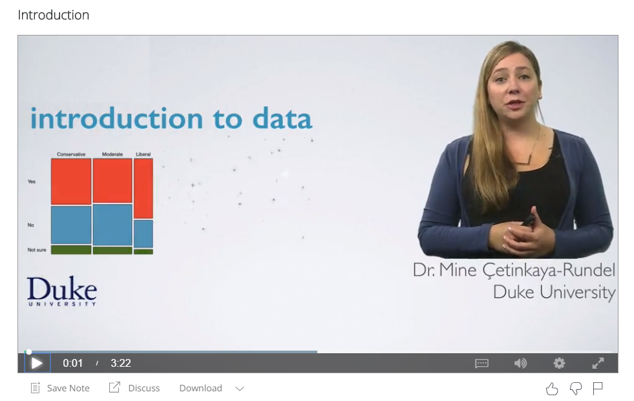
Who’s involved?
Instructor: Dr. Victoria Ellison
Old Chemistry Building 208A
TAs (Old Chemistry Building 203A):
Lecture TA: Lavonne Hoang
Lecture TA: Melanie Lai Wai
Head TA + Lab TA: Tessa Johnson
Lab TA: Tess Chandler
Lab TA: Vanessa Alwan
Lab TA: Morgan Bird
Other:
Dr. Mine Cetinkaya-Rundel
Director of Undergraduate Studies
STA101 Course Designer, Book Author, Coursera Video Designer/Lecturer

Slide 8
Course Overview
Form Research Question
(about Population)
Collect Data (Sample)
Exploratory Data Analysis (of Sample)
*Summary Statistics
*Visualizations
Make Inferences and Conclusions (about Population)
Pictures and summaries of data
Unit 1 - Intro to data: Observational studies & non-causal inference, principles of experimental design & causal inference, exploratory data analysis, introduction to simulation-based statistical inference.

Slide 9
Course Overview
Form Research Question
(about Population)
Collect Data (Sample)
Exploratory Data Analysis (of Sample)
*Summary Statistics
*Visualizations
Make Inferences and Conclusions (about Population)
Building blocks
Mathematics behind statistics
Unit 2 - Probability & distributions: Basics of probability and chance processes, Bayesian perspective in statistical inference, the normal and binomial distributions.

Slide 10
Course Overview
Form Research Question
(about Population)
Collect Data (Sample)
Exploratory Data Analysis (of Sample)
*Summary Statistics
*Visualizations
Make Inferences and Conclusions (about Population)
Statistical inference
Unit 3 - Framework for inference: CLT, sampling distributions, and introduction to theoretical inference.
Unit 4 - Statistical inference for numerical variables
Unit 5 - Statistical inference for categorical variables

Slide 11
Course Overview
Form Research Question
(about Population)
Collect Data (Sample)
Exploratory Data Analysis (of Sample)
*Summary Statistics
*Visualizations
Make Inferences and Conclusions (about Population)
Modeling
Unit 6 - Simple linear regression: Bivariate correlation and causality, introduction to modeling.
Unit 7 - Multiple linear regression: More advanced modeling with multiple predictors.

Slide 12
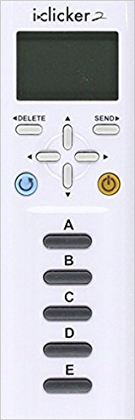
Required for Course
Items:
Book: OpenIntro Statistics, 3rd Edition: http://openintro.org/os
Clicker: i>clicker2
Get: Bookstore or used (See Google Doc for a list of students selling used clickers (link emailed))
Register: In-class
Calculator: (optional) (just something that can do square roots)
Accesses (see syllabus for access information):
Class website: https://www2.stat.duke.edu/courses/Fall19/sta101.001/
Sakai: https://sakai.duke.edu/portal
R-Studio: https://vm-manage.oit.duke.edu/containers
Piazza (on Sakai)
Coursera: https://www.coursera.org/programs/duke-university-courses-gp9dy?authProvider=duke&browseProductType=COURSE&languages=en
DukeHub: https://dukehub.duke.edu/
Teams

Slide 13

General Class Structure: Flipped Class
7 Lecture Units
General Flipped Class Unit Structure:
FIRST: Student goes through primer unit videos (book for clarification) BEFORE the unit is covered in class.
SECOND: Unit discussed more in-depth during in-class lectures (Mondays/Wednesdays) along with in-class application exercises.
10 Labs:
Learn technical data analysis skills related to the unit using R in labs (Thursdays).

Slide 14
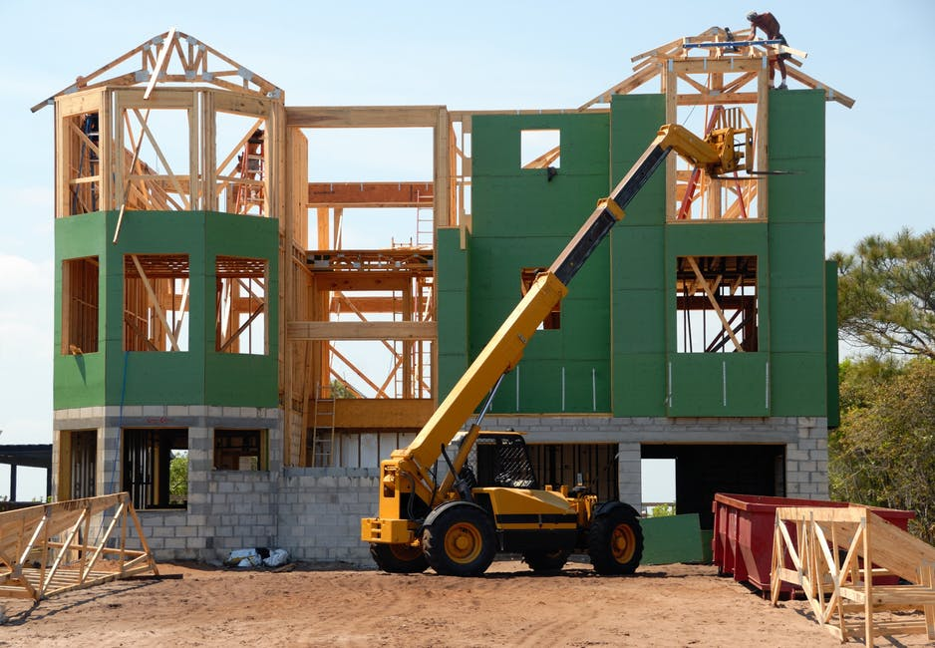
General Class Structure: Flipped Class
In-Class Lecture Notes Key
🔍 Extra Focus
∡ Concept from Different Angle
🆕 Completely New Concept
⚙ Inner Workings/Why does this work?
👫 Relationships Between Concepts
🔮 Building Intuition
✋ Hands-On Exercises
🙃 Common Misconceptions
🖳 Coding
🎰 Game
During a Unit in Lecture:
Lectures/Clicker Questions
Application Exercises (Part of Participation Grade-5%)
How is class different from the videos?

Slide 15
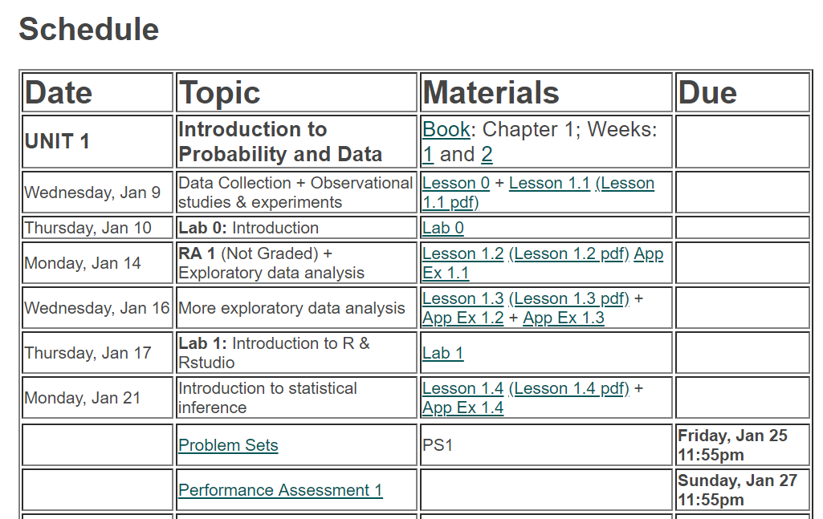
General Class Structure: Flipped Class
Before each unit begins:
Watch and take notes on assigned Unit Coursera videos. (YOU ONLY NEED TO WATCH THE VIDEOS)
Can read book for clarification.
https://www2.stat.duke.edu/courses/Fall19/sta101.001/

Slide 16
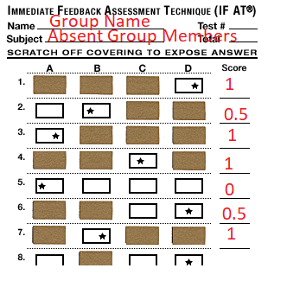
General Class Structure: Flipped Class
When a new Unit Begins:
Take a Readiness Assessment in Class (10%).
Individual Part
7.5%
15 minutes
Group Part
2.5%
10 minutes
https://www2.stat.duke.edu/courses/Fall19/sta101.001/

Slide 17
General Class Structure: Flipped Class
When a new Unit Begins:
Take a Readiness Assessment in Class (10%).
Always 10 MC questions
NO MAKE UPS OR RESCHEDULES
Drop the lowest 2 Readiness Assessments.
Let me know if you are going to miss a 3rd + RA for health reasons, religious holidays, or sports obligations.
https://www2.stat.duke.edu/courses/Fall19/sta101.001/

Slide 18
General Class Structure: Flipped Class
During a Unit in Lecture:
Lectures/Clicker Questions
Individual
Application Exercises (Part of Participation Grade-5%)
Group work
https://www2.stat.duke.edu/courses/Fall19/sta101.001/

Slide 19
General Class Structure: Flipped Class
During a Unit in Lecture:
Lecture Attendance (Part of Participation Grade)
You are allowed to miss three lectures with no penalty.
You must answer 75% of clicker questions to count as having attended the lecture.
https://www2.stat.duke.edu/courses/Fall19/sta101.001/

Slide 20
General Class Structure: Flipped Class
End of a Unit:
Turn in Problem Sets (10%)
Individual
Drop the lowest score
Submit on Sakai Assignments.
Email me know if you miss 2 or more.
Take an end-of-unit Performance Assessment (5%)
Individual
Drop the lowest score
Take on Sakai Quizzes (30 minutes).
Email me know if you miss 2 or more.
https://www2.stat.duke.edu/courses/Fall19/sta101.001/

Slide 21
General Class Structure: Flipped Class
Running in Parallel to Lecture Units:
Each week go to your lab section. Begin and work on the weeks Lab Assignments (10%) Submit before your next weeks lab.
https://www2.stat.duke.edu/courses/Fall19/sta101.001/

Slide 22
General Class Structure: Flipped Class
Running in Parallel to Lecture Units:
Each week go to your lab section. Begin and work on the weeks Lab Assignments (10%) Submit before your next weeks lab.
Must submit html file and rmd file on Sakai assignments.
Drop the lowest score
Email me know if you miss 2 or more lab days.
Missed days of lab result in a 30 point individual deduction from group lab score unless:
You have missed no more than two labs (excused)
AND you either:
complete the whole lab on your own and submit individually OR
complete a significant part of the group lab outside of the lab. (Need approval from group and your lab TA).
Missed a lab and not completing any work results in 0 points on your individual lab assignment grade for that week.

Slide 23
General Class Structure: Flipped Class
Midterm Exams and Final:
Midterm 1 (12.5%) - Monday, Feb 18
Midterm 2 (12.5%) - Monday, Apr 1
Final Exam (25%) - Monday, Apr 29 2:00pm-5:00pm
*No make ups or reschedules! Let me know ASAP if you know that you are unable to make these dates!
*Excused midterm absences will have the midterm grade imputed from the final exam grade.

Slide 24
General Class Structure: Flipped Class
Project (10%):
Presented - Thursday, Apr 18 (during your lab)
Form Research Question
(about Population)
Collect Data (Sample)
Exploratory Data Analysis (of Sample)
*Summary Statistics
*Visualizations
Make Inferences and Conclusions (about Population)
*No make ups or reschedules! Let me know ASAP if you know that you are unable to make these dates!

Slide 25
General Class Structure: Flipped Class
Participation Grade (5%):
Clicker Attendance
Must submit a clicker answer for 75% of the days clicker questions.
(Doesn’t have to be right)
Piazza (on Sakai) participation
Must ask or answers 2 or more questions.
All content related questions ask on Piazza!
Application Exercises (Participation Grade)
Groups must mark down missing group members that day.
Filling out Peer Evaluation Forms
Peer Evaluation Score of your Group Participation

Slide 26
Grades
Participation Attendance (3 late or unexcused absences dropped) Peer evaluation Other Participation In-class Piazza Forum participation Application Exercises | 5%
Problem sets (drop the lowest grade) | 10%
Labs (drop the lowest grade) | 10%
Readiness assessments (drop the lowest grade) | 10% (75% individual, 25% team)
Performance assessments (drop the lowest grade) | 5%
Project | 10%
Midterm 1 | 12.5%
Midterm 2 | 12.5%
Final | 25%
Grading:
Grades may be curved at the end of the semester. Cumulative numerical averages of 90 - 100 are guaranteed at least an A-, 80 - 89 at least a B-, and 70 - 79 at least a C-, however the exact ranges for letter grades will be determined after the final exam. The more evidence there is that the class has mastered the material, the more generous the curve will be.

Slide 27

Teams
Assigned based on:
Getting to Know you Survey
Pre-test
Absolutely can’t work with someone in your lab section?
Work together on:
Lab Assignments (always record attendance/work contribution)
Application Exercises (always record attendance)
Group part of Readiness Assessments (always record attendance)
Other:
Sit together in lecture and lab
If a group problem arises, let me know sooner rather than later.
Peer evaluations

Slide 28

Tips for Success
I will regularly send announcements by email, please make sure to check your email daily.
Complete the videos/reading before a new unit begins, and then review again after the unit is over.
Be an active participant during lectures and labs.
Ask questions - during class or office hours, or by email. Ask me, your TAs, and your classmates.
Do the problem sets - start early and make sure you attempt and understand all questions.
Start your project early and allow adequate time to complete it.
Give yourself plenty of time to prepare a good cheat sheet for exams. This requires going through the material and taking the time to review the concepts that you’re not comfortable with.
Do not procrastinate - don’t let a unit go by with unanswered questions as it will just make the following unit’s material even more difficult to follow.
For more tips, see Course Tips

Slide 29
Policies: When in doubt… check with the syllabus first!

